Slide 1
What Is the Property and Liability Insurance Business?
by
Emilio Venezian

Slide 2
My colleagues all over Asia
Are awed by all the empirical papers on insurance that people in the United States publish based on the data sources available there.
Actually the sources we have are not so good.
And maybe it follows that the papers are not so good.
I will talk mostly about the databases.
The problems go much deeper, so I am not talking about the iceberg,
or the tip of the iceberg.
Maybe I cover the hair on that back of the bear sitting on the iceberg.

Slide 3
To cover more than that we would have to know
How does an insurer account for a loss
  incurred in Thailand
  caused by a product manufactured in in China
  sold by a distributor in Germany and
  produced by a U.S. company
  domiciled in Vermont
That negotiated a policy with a 10 million dollar aggregate deductible.

Slide 4
Why should we care?
Empirical research requires the use of data.
The data sources available to us differ even in the number of units that they include in any given year.
It is useful to have some rough measures of the size of the business (and its components) so we can assess how complete the data sets are.
The answers can serve both to decide which data base to use and to assess the credibility of the results.
Or even to decide whether we should believe a study based on only one data source.

Slide 5
Why is this not known more widely?
The people who sell the data are not going to tell you.
The authors that use the data in their research won’t tell you either.
And the editors of the journals do not want to print comments that say the data is not what the authors say it is.
So everybody writes about how good the data is.
Nobody really is interested in assessing reality.
Eventually everybody comes to accept it as the truth.
With maybe a few exceptions.

Slide 6
An example of how confusion is spread
Winter (1994) states: “The actual data are annual for the aggregate U.S. property-liability market over the period 1948-1988” and then proceeds to present data for stock insurers “from ‘Best’s Averages and Aggregates’ (sic).”
Best’s is not, and has never pretended to be a complete enumeration of the U.S. market or even of the stock insurers operating in the U.S.
Worse, Winter models the whole market and stock companies lost market share to mutual companies fairly steadily over the period that he uses, 1948-1988.
But that also depends on whether you count fully owned stock subsidiaries of mutual companies as “stock companies” or “mutual companies.”

Slide 7
I would like to cover a few basic points
To look at what different sources tell us about the size of the P&L insurance business.
To compare the results and see if we can guess at the sources of the differences.
I will look specifically at two items:
  the total number of companies, and
  the total premiums they write.
We could also talk about total assets, but that is much more complicated and we do not have the time.

Slide 8
Overall Results
There appear to be somewhere between 2,400 and 3,300 P&L insurers in the U.S.; roughly
  1,875 to 1,975 are stock insurers,
  420 to 490 are mutuals,
  57 to 68 are reciprocals, and
  63 to 65 are Lloyds.
The annual premiums appear to be in the range of 280 to 330 billion dollars.
Their liquids assets (which I do not cover in this talk) appear to be in the range of 690 and 865 billion dollars.
The magnitude of these ranges may make you uneasy.
And feel more comfortable using your own data.

Slide 9
Major Sources
Two major sources used in empirical studies are:
  A.M. Best’s Aggregates and Averages
  NAIC
These are the ones most often used in research, especially longitudinal studies of the P & L business.
They are available on electronic media which makes them convenient.
People will lead you to believe that these are time series.
They are not; they are a collection of cross-sections with not enough continuity or homogeneity to rate as a time series.
Standard and Poors also has data in electronic form, but I have never had access to it.

Slide 10
Other Sources
Are, so far as I know, available only in hard copy.
The Insurance Information Institute (I.I.I.) has provided counts of P&L companies by state for a long period of time.
More recently, OECD has published data on the insurance business.
Best’s “KeyGuides” are also useful.

Slide 11
Other Sources (continued)
There are various other sources which have provided information over limited time spans. These are not included in this study, mostly they indicate that reciprocals and Lloyd companies are much more numerous than those reported in A.M. Bests A&A.
The U.S. Census is notable by its absence among direct sources. Their data on insurance comes from either I.I.I. or A.M. Best’s.
If your country has a census that includes insurers you may have much better data even if it is not so frequent.

Slide 12
Two obvious problems
A count represents the number of entities present at a given time. None of the sources gives a clear indication of a specific time at which the enumeration might be valid.
What is a P&L insurer is also a matter of concern.
  Is it a company with a charter in at least one state?
  Does it have to operate in more than one state?
  Is it a company that is actually chartered and funded?
  Does it need to have conducted any insurance business in the year in question?
  Or ever?
The publications do not tell us, so your guess is as good a mine.

Slide 13
Less obvious problems
There are, of course, many less obvious problems.
The most important of these will be discussed later.
But there is one problem of MAJOR importance:
Neither A.M. Bests A&A nor the NAIC database should be considered time series.

Slide 14
They are sequences of cross-sectional data
The A&A for property and casualty, has the longer history and provides hard copy with annotations about changes.
It is rare to find a five-year period with no major change in the data.
The companies included in the publications vary
  in 1900 it included only stock companies writing fire insurance,
  by 1949 it included stock, mutual, reciprocal, Lloyds, and factory mutual companies in any line of property and liability
  PLUS the income side of all health coverages of life insurance companies…
  but none of the balance sheet information
The definitions of lines of insurance also change.
It is not always possible to tell whether a new line was just an innovation, had previously been part of another line, or had been part of a “miscellaneous” entry.
The definitions of asset classes and liabilities.
In particular information on, inter-company holdings varies over time.
If you interpret these as series you do so at your own peril.

Slide 15
Even in shorter sequences
  The companies included change from year to year not just with entries and exits into the business but also with omissions.
My estimate is that no more than 95 percent of active companies are actually in the databases in any one year.
The definitions of lines of insurance also change.
So do the definitions of asset classes and liabilities.
If you interpret these as series you do so at your own peril.

Slide 16
In 1950
Best decided to move the accident and health business written by life and health companies to the book on accident and health, as a result
  over 100 L&H companies disappeared from the P&L book, but
  the total number of companies in the P&L book increased.
So over 100 smaller P&L companies were substituted for the large L&H companies removed.
I estimate that the accident and health premium that was shifted amounted to 6 percent of the total premium.
Of course none of the assets were shifted, but the substitution had some relatively small) effect on the surplus.
So I never consider using data from before the mid-1950s.

Slide 17
The number of insurers

Slide 18
The Number of Insurers

Slide 19
A Synopsis
The holes in the data correspond to publications that I could find neither the Temple University Library, the University of Pennsylvania Library, not the College of Insurance Library.
The I.I.I. numbers are much higher than those of other sources until the mid-nineties.
The OECD, which enumerates “non-life” rather than “P&L” is the next highest.
The NAIC “all”, which includes risk retention groups, captive insurers, and reinsurers is the next highest.
It is worth noting that the NAIC is interested primarily in entities that operate in more than one state.

Slide 20
Interesting Points
Best’s A&A’s coverage appears to have increased substantially over time, especially in the late 1980’s.
That is probably when competition with the NAIC data base became significant.
I say that because I know that in 1981 and 1982 the NAIC data base had many errors.
Best’s A&A sometimes has fewer insurers that their Rating Guide.
The NAIC data includes some 800 insurers fewer than the I.I.I. and some 300 fewer than the issues of Best’s KeyGuide that give both rated and unrated companies.

Slide 21
Problems and sources of difference
I have no way of knowing how many of the insurers in one set are included or missing from any other set.
Or how many included in one year are included or missing in the following year.
The I.I.I. publications have problems.
  Some issues of “Insurance Facts” appear to mislabel the year to which the numbers pertain.
  Insurers by state do not always add up to the total.
OECD uses “non-life” rather than “P&L”; the difference is primarily from companies that write only health coverages.
It may also include mortgage insurers, title insurers...
Best’s basis changes over time from “casualty” to “fire and casualty” to “property and casualty” to “property and liability”.

Slide 22
Another Perspective

Slide 23
Overview
Over the years the coverage in Best’s A&A as a percent of insurers enumerated by I.I.I. has increased steadily.
The NAIC coverage also appears to be increasing.
It may be that I.I.I. numbers represent the insurers licensed to do business in the individual states, some of these may not be operating.
I think we are allowed to assume that if an insurer is listed in either the A&A or the NAIC database it is actually operating.
That does not mean that every operating insurer is in either data base.
In particular, insurers that operate in only one state are probably under-represented.

Slide 24
Premiums

Slide 25
Premiums
The comparison of premiums is complicated by the “P&L” versus “non-life” differences.
A crude comparison is provided in the graph.

Slide 26
Data on Premiums

Slide 27
Overview
It is clear that the OECD “non-life” premium data overstates the total “P&L” net premium written.
Removing the accident and health premiums from both the “non-life” and “P&L” totals brings the two sets of data into much closer agreement.
The discrepancy in the adjusted data is much larger for 2000 than for the earlier years.
Lines other than accident and health appear to contribute little to the difference between “non-life” and “P&L”

Slide 28
Some Potential Problems
The NAIC data, which I have in some detail, suggests some potential problems:
  In each of the years some 100 companies (about 4 percent) have zero written, earned, and direct premiums , they account for less than 0.2 percent of industry assets.
  Companies with zero net premium written in any given year account for 4.9 to 22.1 percent of the total assets of insurance companies in the NAIC data.
  The largest such company in any given year accounts for 3.5 to 4.3 percent of the total assets and reinsures all its business.

Slide 29
More Potential Problems
For the period covered a number of companies (15 to 67 in individual years) have gross financial assets (liquid financial assets plus investment in affiliated companies) in excess of admitted financial assets.
  The largest ratios of gross financial assets to admitted assets for the aggregate of these companies in the year ranges from 1.4 to 2.3.
  According to the NAIC staff, these companies are small and typically have negative agents’ balances.

Slide 30
Some comments
The data are generally consistent but suggest that there are problems in comprehensiveness.
The fact that the number of companies in Best’s A&A is occasionally lower than that in the KeyGuide is of particular concern. It implies that the A&A data sometimes omit individual insurers.
This arises because some insurers did not report their data on a timely basis.
In turn that implies the Best is still providing ratings for insurers that have not submitted data.

Slide 31
I found that of special concern
My working hypothesis is that companies that are in trouble will tend to skip reporting to Best and seek waivers from the regulators from filing with the NAIC.
The only way I could think of testing that hypothesis with the available data was to examine the relation between the change in the number of companies reporting and the major components of income.

Slide 32
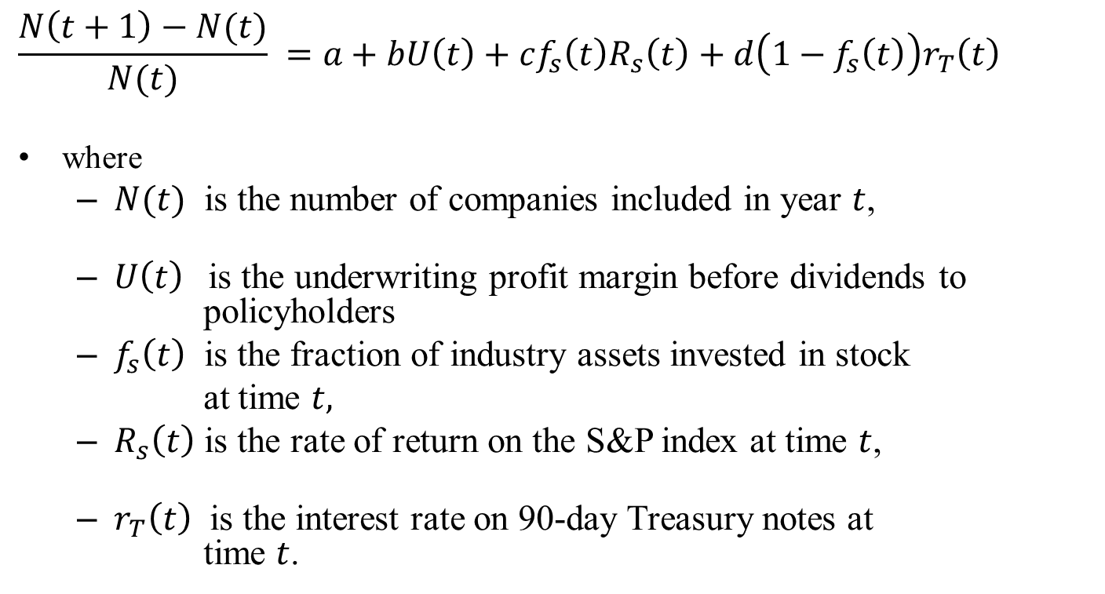
I used as a model
$$\frac{N\left(t+1\right)−N(t)}{N(t)} =a+bU\left(t\right)+cf_{s}\left(t\right)R_{s}\left(t\right)+d\left(1−f_{s}\left(t\right)\right)r_{T}\left(t\right)$$
where
  $N(t)$ is the number of companies included in year $t$,
  $U\left(t\right)$ is the underwriting profit margin before dividends to
  policyholders
  $f_{s}\left(t\right)$ is the fraction of industry assets invested in stock
  at time $t,$
  $R_{s}\left(t\right)$ is the rate of return on the S&P index at time $t$,
  $r_{T}\left(t\right)$ is the interest rate on 90-day Treasury notes at
  time $t$.

Slide 33
Using data from 1952 to 2001
The results for stock companies were:
The intercept is not significantly different form zero, as one might expect.
The sign of the other coefficients are consistent with the hypothesis that companies do not report when they are in trouble.
For mutual companies the results were weaker but with the same signs for the three meaningful coefficients.

Slide 34
It seems that
It is not wise to ignore the effects of self-selection.
Nobody seems to worry about that in the case of companies.
But a great deal of our literature is devoted to self-selection by policyholders.
I do worry, and am actively trying to get data on individual companies that do not file.

Slide 35
Some recent findings
Recent versions of the Best and NAIC data reveal some interesting features:
  Most spelling mistakes in the company information are exactly the same if both.
  I believe that arises because companies now submit the same electronic documents to both but it could also be that they buy each other’s databases.
  A few groups that at classified as P&L by Best and classified as L&H by NAIC.

Slide 36
Worry, worry, worry
Private communications with A.M. Best’s have confirmed that failure to report data is a reason for exclusion.
This is of concern because that makes inclusion in the A&A a matter of self-selection.
Analyses conducted so far indicate that incomplete reporting is not uncommon and suggest that poor operating results may be a factor in the decision to not submit data on a timely basis.

Slide 37
Conclusions
The major sources of data cover a high proportion of the P&L insurance activities in the United States.
Each set has its own limitations.
No set is completely comprehensive and in both sets the data across years may not be comparable because of exclusions due to failure to submit data.
Self-selection may play a role in the submission process so any analysis should assess the possible effect of this on the results.

Slide 38
And
Empirical work needs to be interpreted with a great deal of skepticism.
“Support” based on the data should not be taken as solid proof that the underlying model is correct.
Thank you for your attention!

Slide 39
Thank you for your attention!

Slide 41
Assets

Slide 42
Assets
Over the long term there are two sources for assets of insurance companies:
  The “FoF” reports of the Federal Reserve Bank.
  Best’s Aggregates and Averages.
The NAIC and OECD have only relatively recent data.
The FoF reports give “liquid assets” and appear to apply to “non-life” insurance.
Comparisons are not so easy because “liquid assets” are not defined in detail and there are issues of consolidation versus aggregation.

Slide 43
Notation
The graph uses
  “GFA” for gross financial assets, LFA plus investments in affiliates.
  “LFA” for the sum of bonds, common and preferred stock, cash, and short-term investments.
It labels as “Agg” the aggregate numbers, all others are my best attempt at consolidated numbers.

Slide 44
The Data
A plot, even on a logarithmic scale would not be very helpful.
Over the period 1950 to 2000 the assets increased approximately 100 fold.
The assets as a percent of those given in the FoF reports are shown in the figure.

Slide 45
Assets/FoF “Liquid Assets”

Slide 46
Overview
If you accept my view of what “financial assets” might mean, Best’s A&A accounted for about 90 percent of those counted in the FoF report in 1950 and declined to 80 percent of those counted in the FoF report of 2000.
Remember that FoF counts liquid assets of other insurance, not just property and liability, so this does not necessarily represent an adverse trend. We would need to know how other lines, such a title, mortgage guarantee, and so on fared in the interval before we can reach a conclusion.

Slide 47
Data by Segment—Stocks and Mutuals

Slide 48
Data by Segment—Reciprocals and Lloyds

Slide 49
Overview
Despite differences, the NAIC data base and the A&A data base now cover the non-captive private market to about the same extent.

